Slide 1
PHASED ARRAY SPEAKER SYSTEM
By,
RajaRaman Ganesan

Slide 2
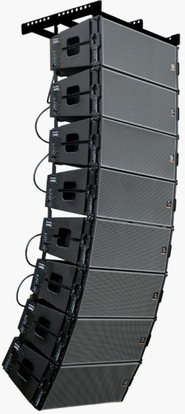
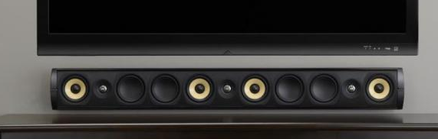
PHASED ARRAY SPEAKERS
Over the past few decades, digital signal processors (DSPs) have become available at a reasonable cost. This forces the question Now that it is possible to individually control the magnitude and phase of every loudspeaker in an array called phase array speaker system.
Manipulating the magnitude and phase of every loudspeaker in an array of loudspeakers is commonly referred to as “beam steering.”
Line Array systems
Phase Array systems

Slide 3
OBJECTIVE
The aim of the phased array speakers is to provide the maximum sound coverage over an entire area along with best sound clarity. The voices and the sound effects could be more easily differentiated. This system is comparatively cheaper when compared with its counterparts.

Slide 4
INTRODUCTION
A phased array speaker system to generate flexible, directional sound.
The system samples a standard audio input signal at approximately 44.1 kHz, and then outputs this signal to each of 6-12 speakers, each with a variable delay.
This simple technique allows audio frequency sound to be heard in only selected regions within the room or other auditory space.
Multiple regions with multiple soundtracks can be created by simultaneously playing variously delayed soundtracks over each of the speakers in the array.
Sound waves from different loudspeakers can both combine or cancel depending on the relative phase relationships between the sound waves, it is possible to manipulate the phase (and magnitude) of the sound from two or more loudspeakers to control where the sound cancels and where the sound sums.

Slide 5
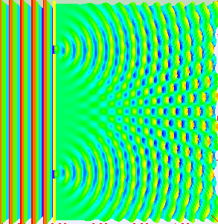
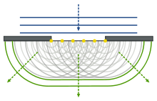
EMERGING OF DIRECTIONAL SOUND

Slide 6
HARDWARE DESIGN
X12
STANDARD AUDIO INPUT
PRE AMPLIFIER
AADC
ATMEGA 644 MICROCONTROLLER
DAC
SPEAKER AMPLIFIER

Slide 7
MODULES USED
Standard audio input
Pre Amplifier Block
ADC
ATMEGA 644 Microcontroller
DAC
Speaker Amplifier
Speaker

Slide 8
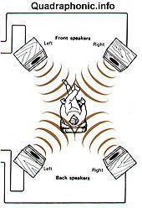
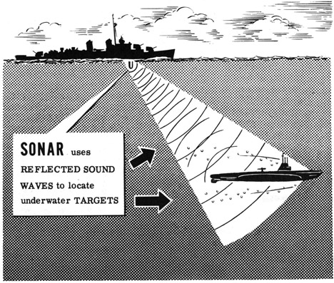
APPLICATIONS
Quadraphonic
Sonar testing apparatus

Slide 9
SOFTWARE USED
WinAVR used for programming the microcontroller.
EAGLE software to design circuits for fabrication.

Slide 10
SOFTWARE DESIGN
Power On
Timer 1 Interrupt
MCU initialization
Set Time-delayed DAC Output
Sample input Potentiometer
Sample and Store New Input Data
Store New Delay Adjustment

Slide 11
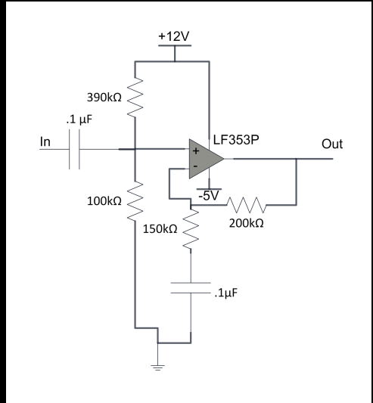
PRE AMPLIFIER CIRCUIT
Corner frequency of this input high pass filter 1/(RC)= 1/(.1u*80k)
=125hz.
The amplification factor is 1+(R1/R2)=1+(200k/150k)
=2.33

Slide 12
DESCRIPTION
The first stage is a high­ pass filter and re­-biasing circuit, implemented by the first capacitor and the resistor divider.
The second stage of the input amplifier is implemented with an LF353P Op-­Amp in a non­-inverting amplifier.
It amplifies only the high ­frequency components due to the capacitor between the lower resistor and ground.
Voltage swing from -1V to +1V to be converted to -2.33V to +2.33V finally it will be almost double to 5v.

Slide 13
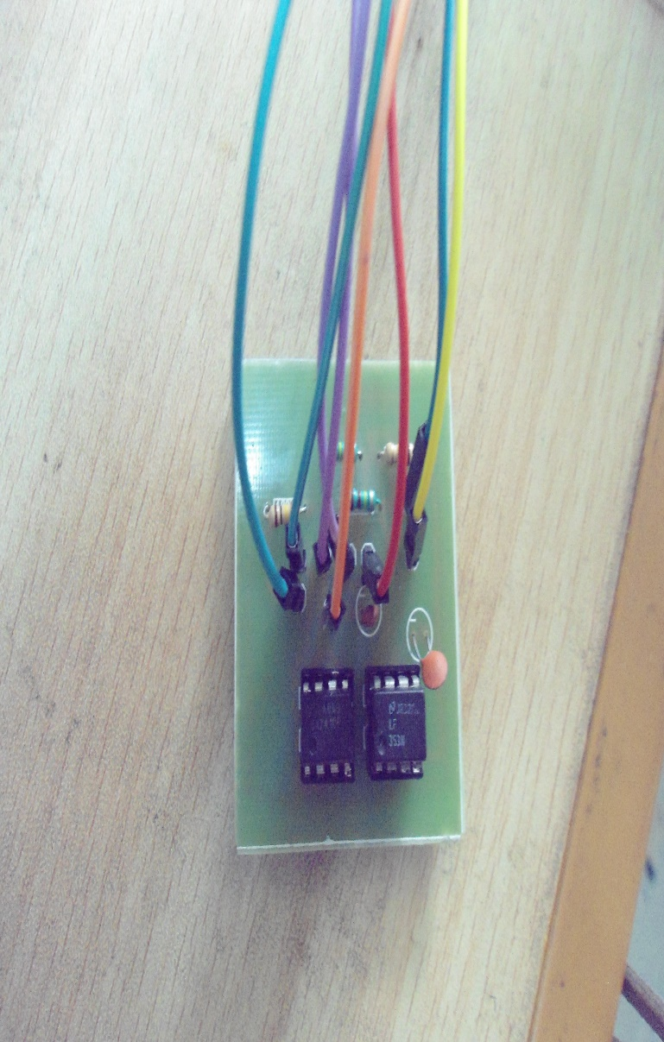
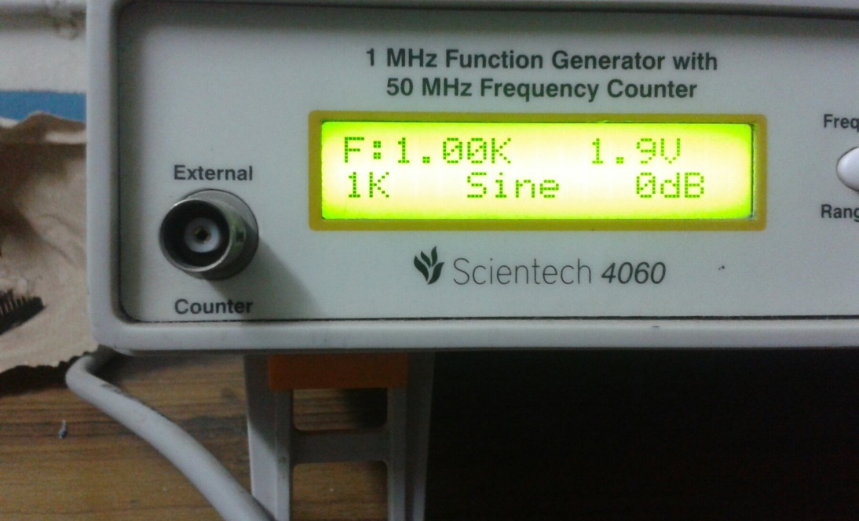
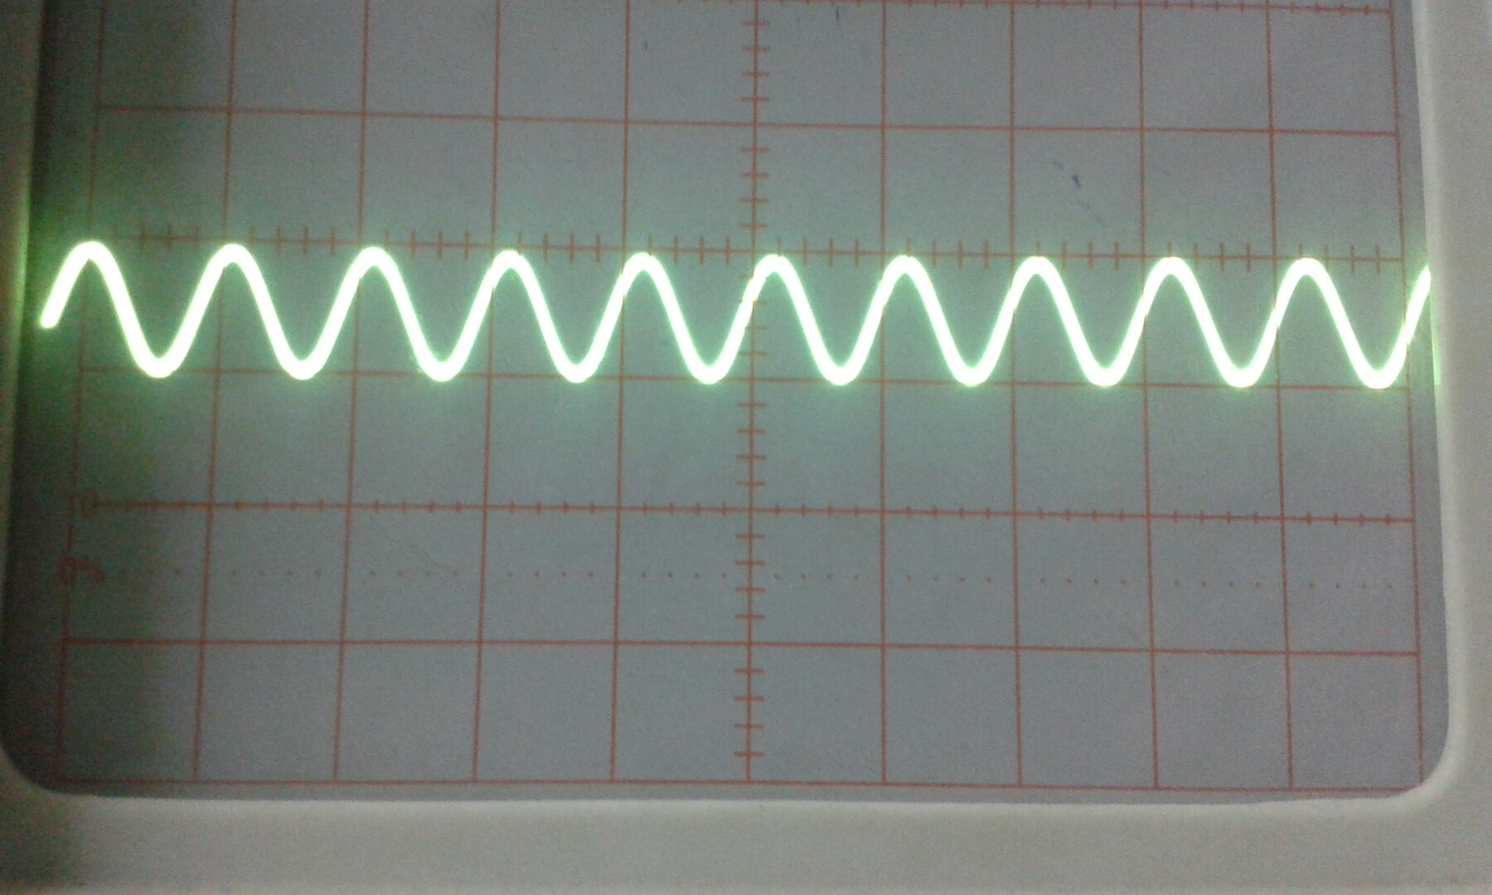
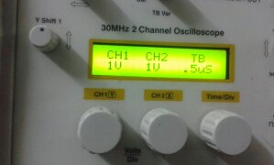
PRE AMPLIFER TESTING

Slide 14
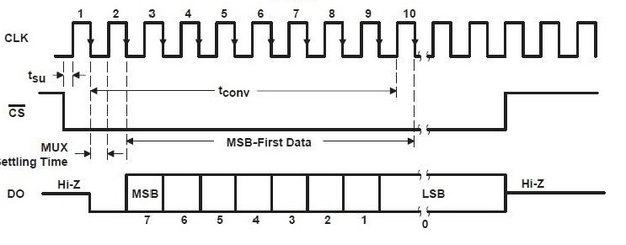
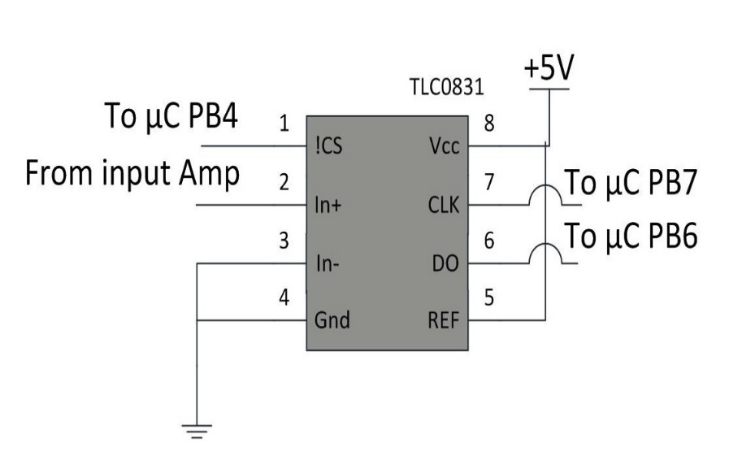
ADC
ADC is used to sample input audio signal.
It takes 10 cycles to transmit the 8 bits of data.

Slide 15
ALGORITHM
Initialization of microcontroller.
Declaration of buffers.
Setting up of timer and ADC.
Discrete audio signals are delayed with appropriate coding and o/p is sent to respective i/p pins of DAC.

Slide 16
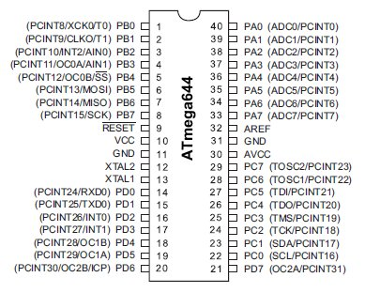
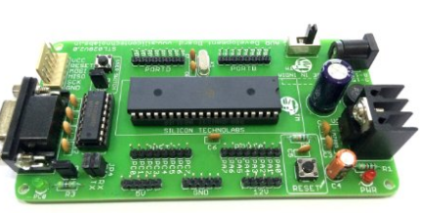
MICROCONTROLLER
The microcontroller used in this setup is the AT-mega 644.
The microcontroller must have at least 13 I/O pins,
1 ADC input, and SPI capabilities.
The crystal used in this setup should be 20MHz.
a) DEVELOPMENT BOARD b) PIN CONFIGURATION

Slide 17
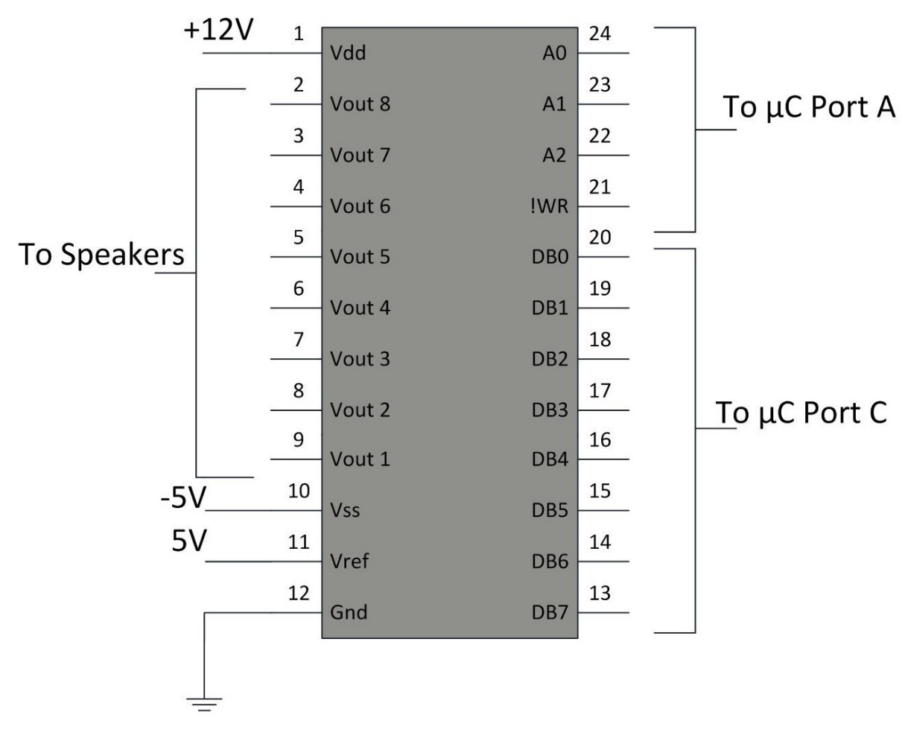
DAC
The DAC we use here is a parallel DAC.
This is used for a faster execution.
DAC what we use here is more flexible
which works at the rate of 44.1 KHz.

Slide 18
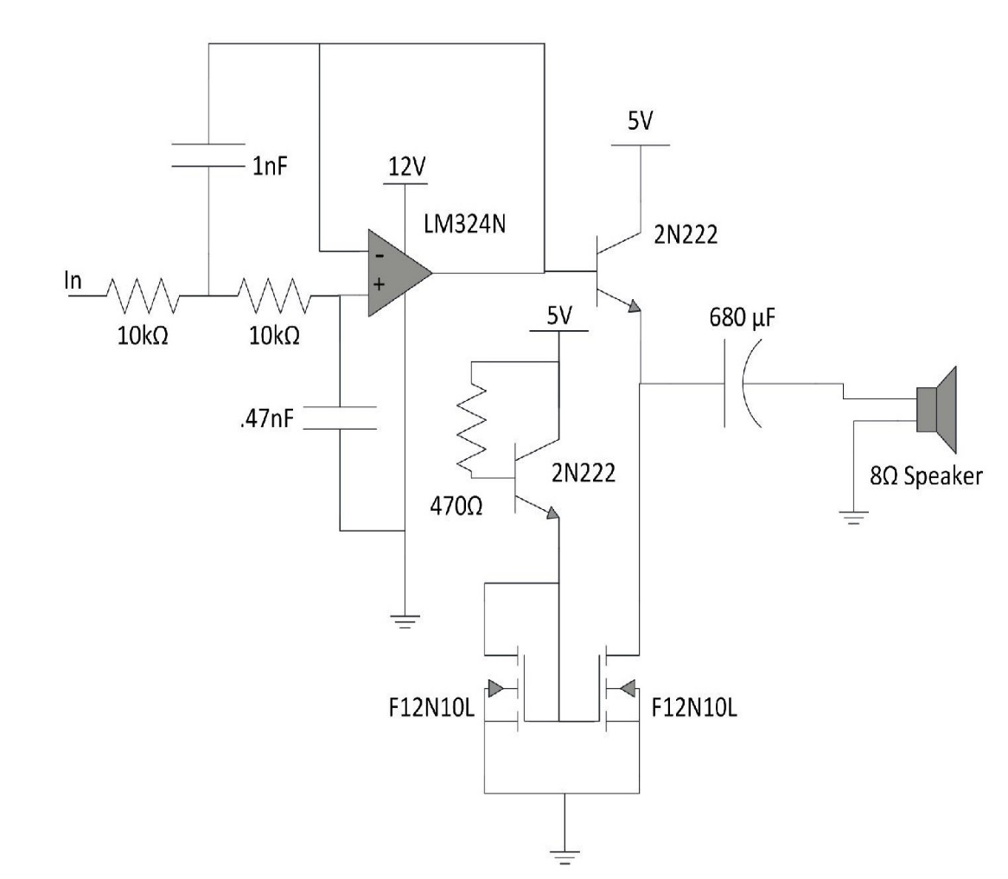
SPEAKER AMPLIFIER
For better amplification at end of circuit we make use of another amplifier to provide better output.
A Butterworth filter was selected over
cascading two passive RC filters.
An op­-amp with a really high slew rate
may be necessary if the application is
dealing with frequencies above the
human range of hearing.

Slide 19
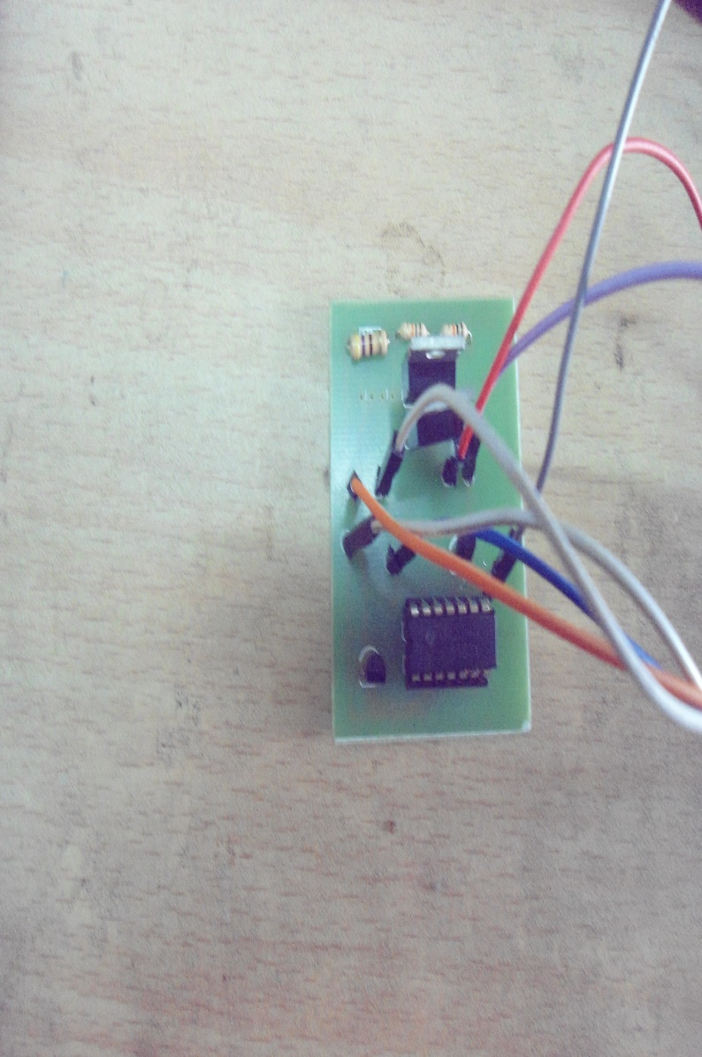
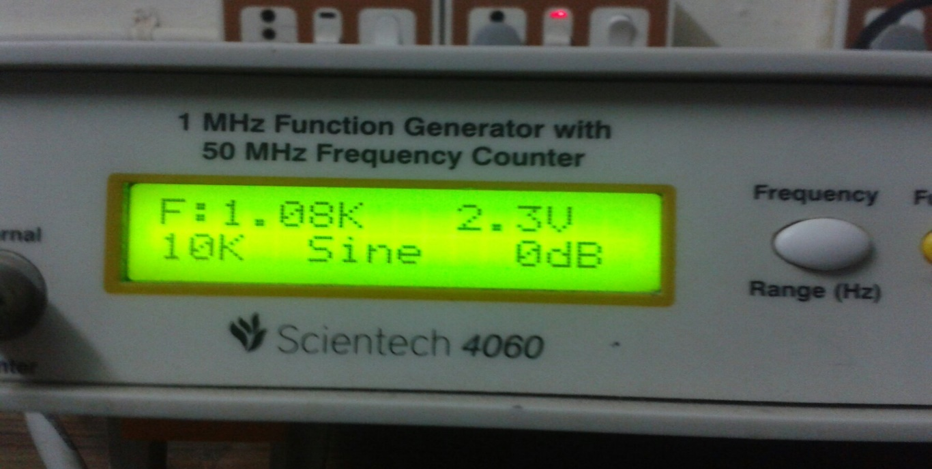
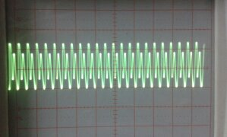
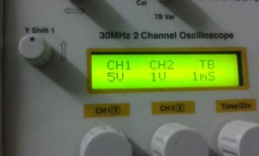
POST AMPLIFIER TESTING

Slide 20
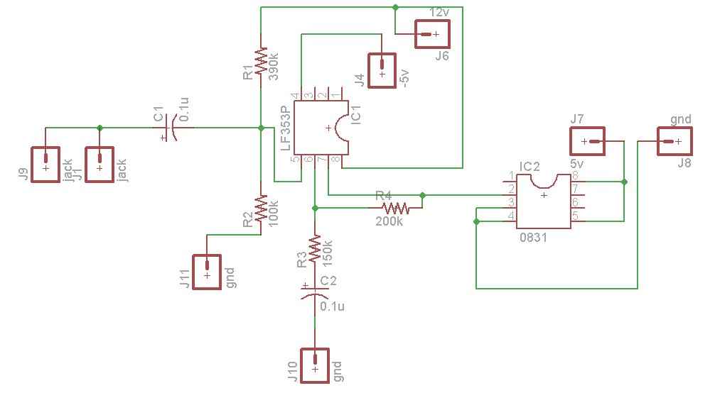
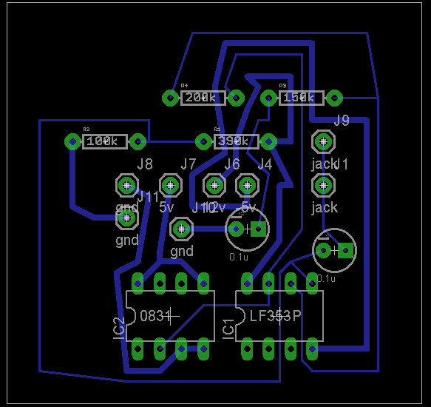
PRE AMPLIFIER ON EAGLE SOFTWARE

Slide 21
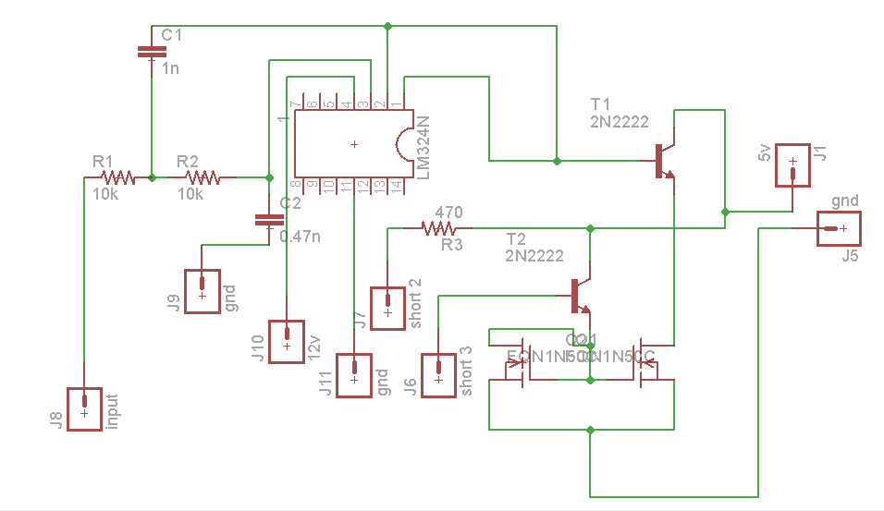
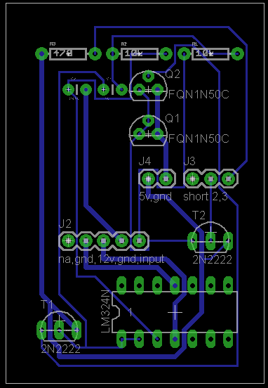
POST AMPLIFIER ON EAGLE SOFTWARE

Slide 22
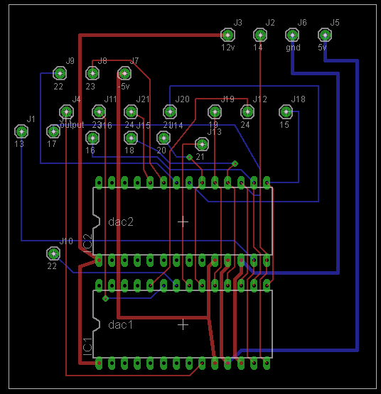
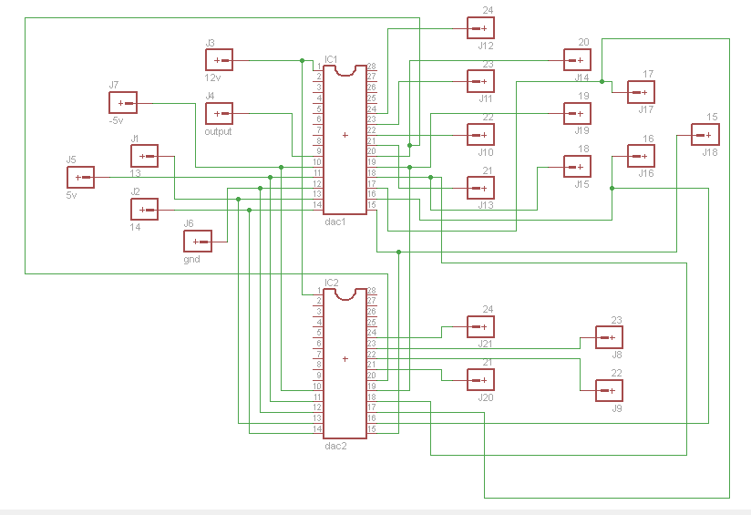
DAC ON EAGLE SOFTWARE

Slide 23
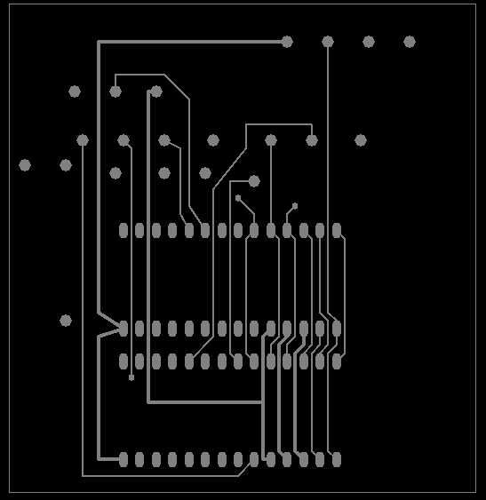
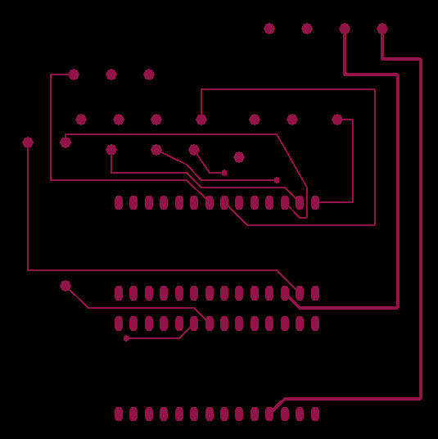
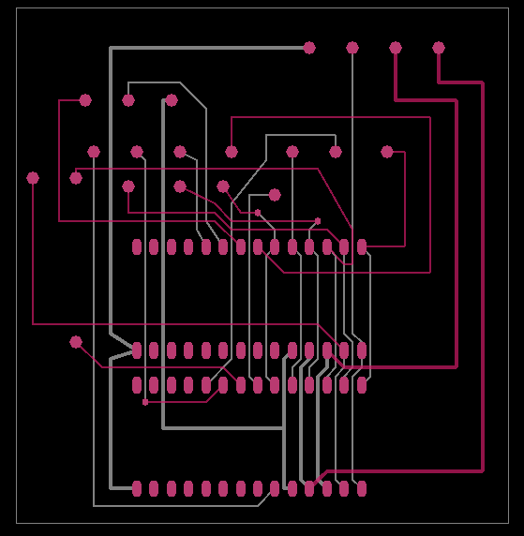
PCB LAYER IN DAC DESIGN
TOP LAYER BOTTOM LAYER DOUBLE LAYER

Slide 24
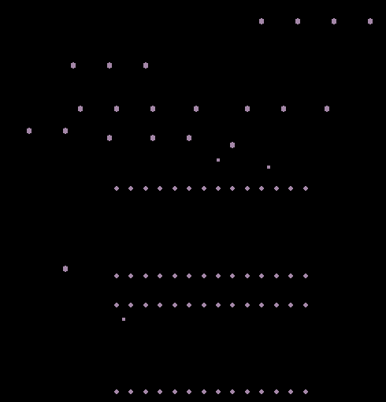
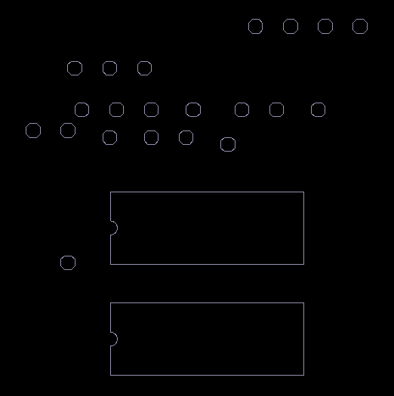
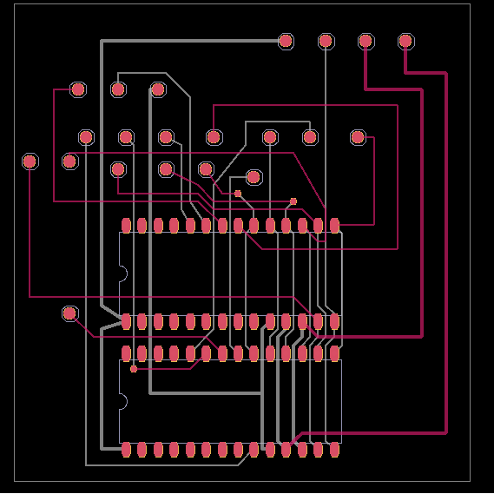
PCB LAYER IN DAC DESIGN
DRILL LAYER SILK SCREEN OVERALL DESIGN

Slide 25
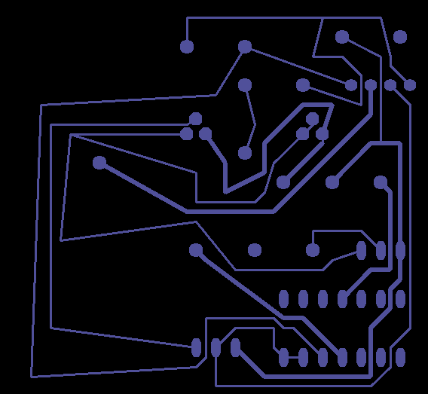
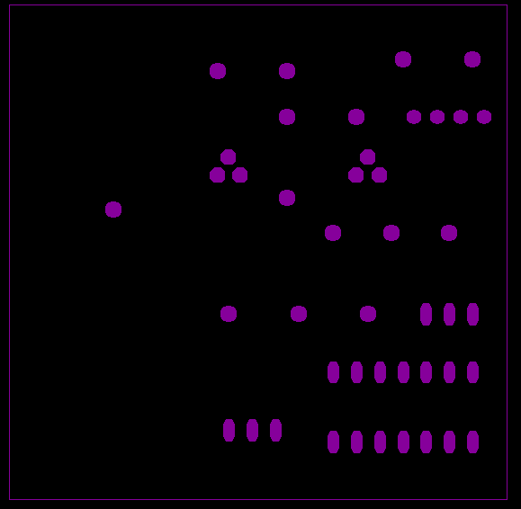
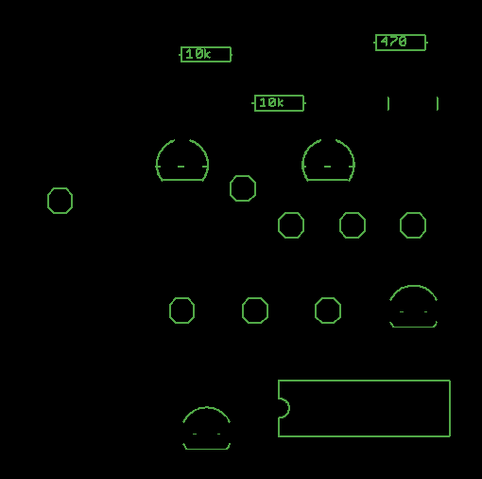
PCB LAYER FOR POST AMPLIFIER
BOTTOM LAYER TOP LAYER SILK SCREEN

Slide 26
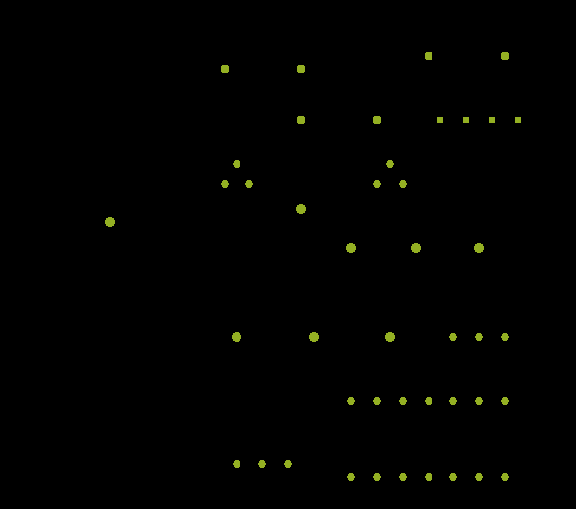
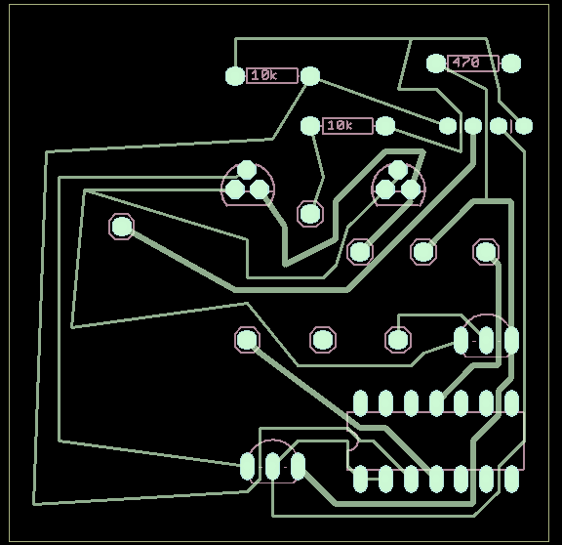
PCB LAYER FOR POST AMPLIFIER
DRILL LAYER OVERALL DESIGN

Slide 27
PCB LAYER FOR PRE AMPLIFIER
TOP LAYER BOTTOM LAYER SILK SCREEN LAYER

Slide 28
PCB LAYER FOR PRE AMPLIFIER
DRILL LAYER OVERALL DESIGN

Slide 29
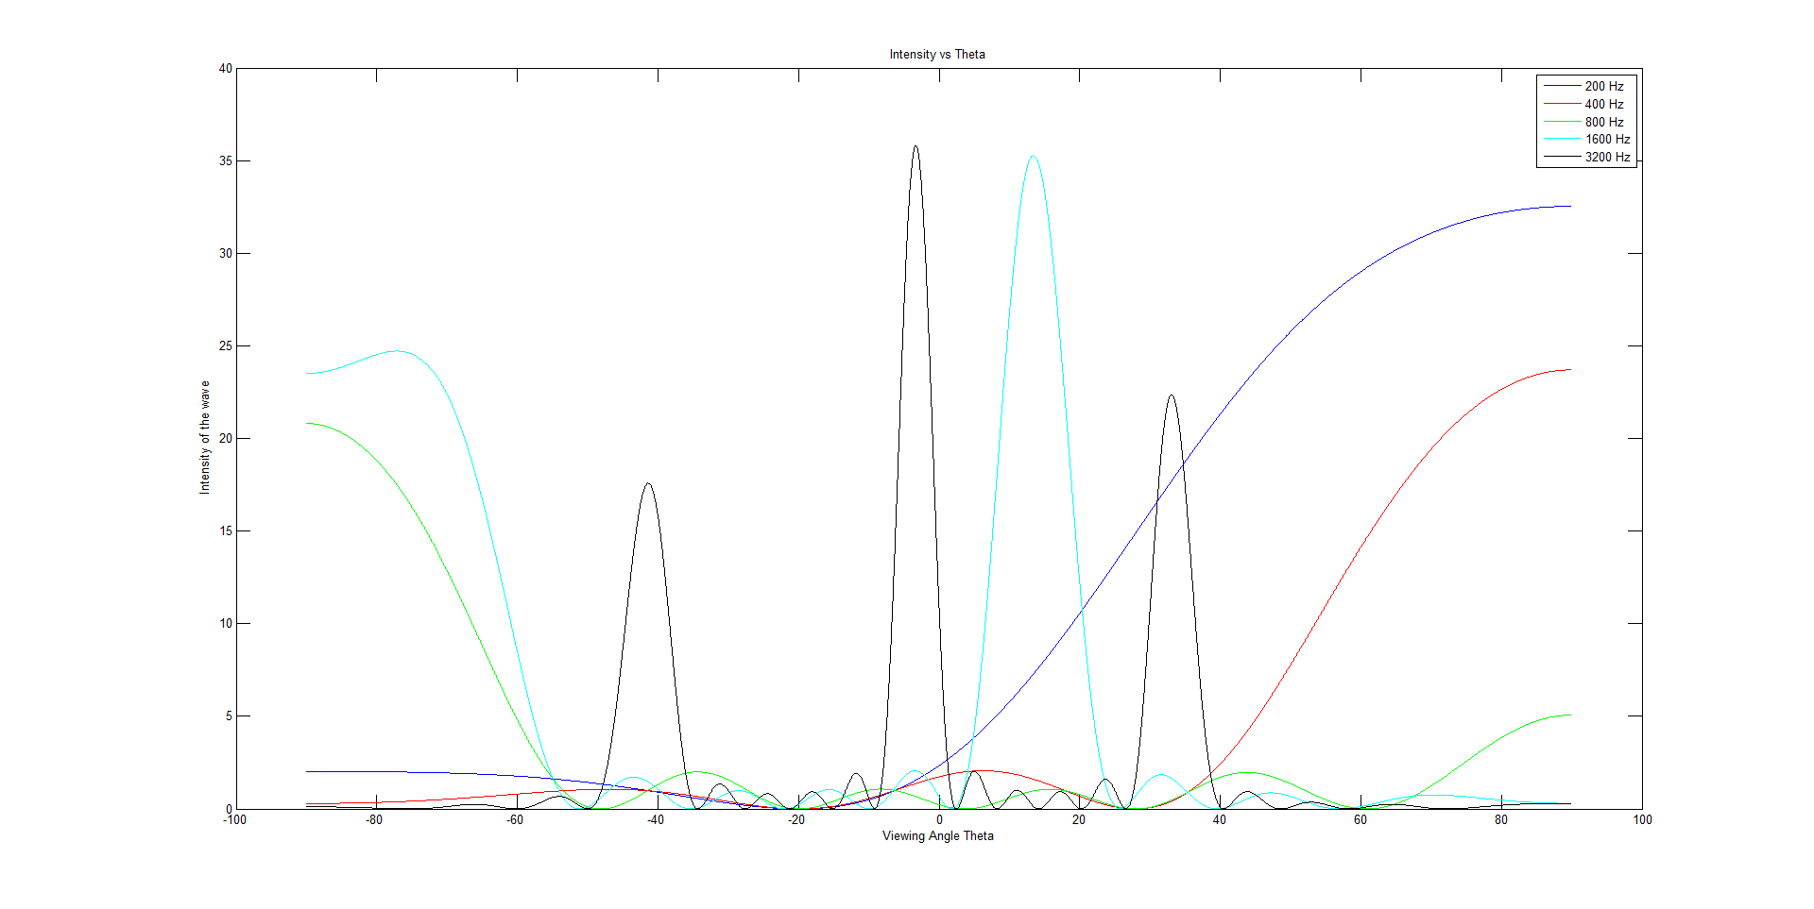
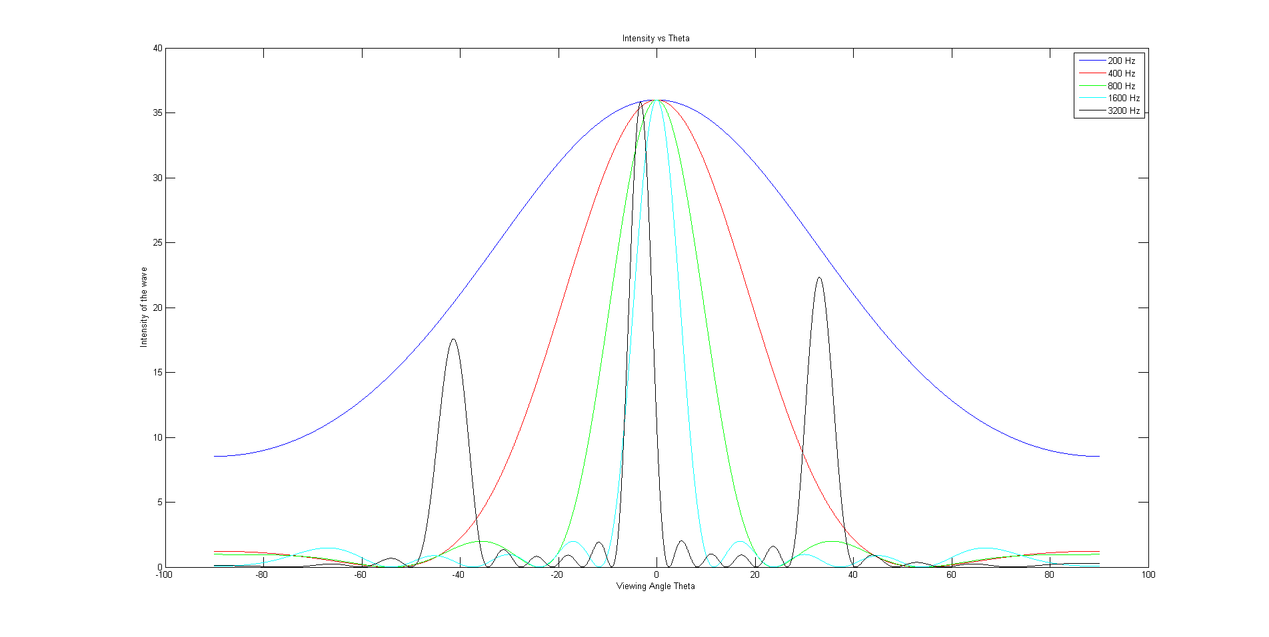
MATLAB SIMULATIN OUTPUT
Without Delay
30ms Delay

Slide 30
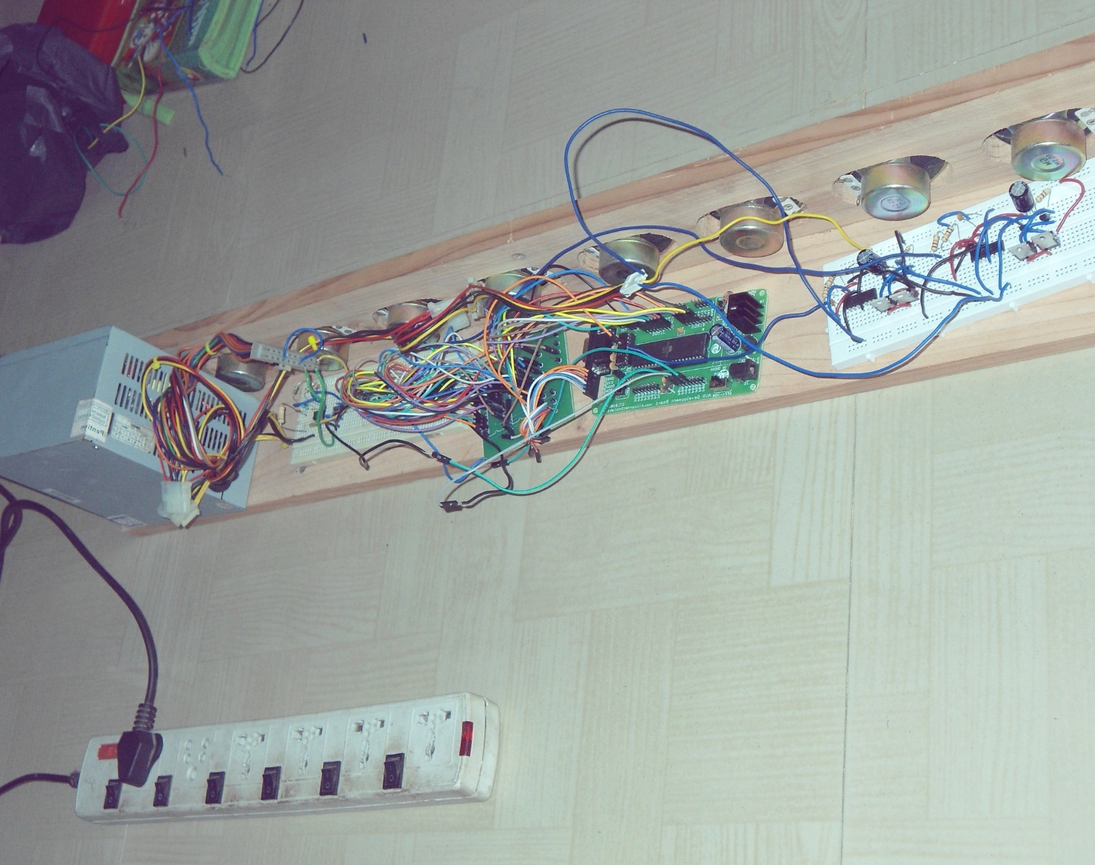
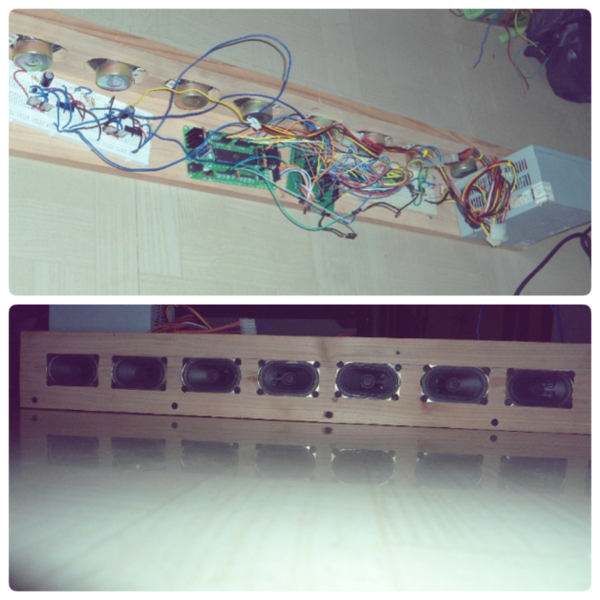
SPEAKER ALIGNMENT

Slide 31
REFERENCES
Paul Crilly, Richard Hartnett, Rosie Santrach, Carlos Palenzuela Department of Engineering, Electrical Engineering, U.S. Coast Guard Academy, New London “A Novel Approach to Teaching Phased Array Antenna Systems”
Joseph Spradley, "A Volumetric Electrically Scanned Two-Dimensional Microwave Antenna Array," IRE National Convention Record, Part I – Antennas and Propagation; Microwaves, New York: The Institute of Radio Engineers, 1958, 204–212.

Slide 32
THANK YOU

